Slide 1
Beamformer
Owen Stuttard
Abraham El-Jakl

Slide 2
Project Description
Design and implement a simple beamformer on the DE2 boards that can take 8 channels of raw data and creating a single line for an ultrasound image that can be outputted back via UART Protocol.

Slide 3
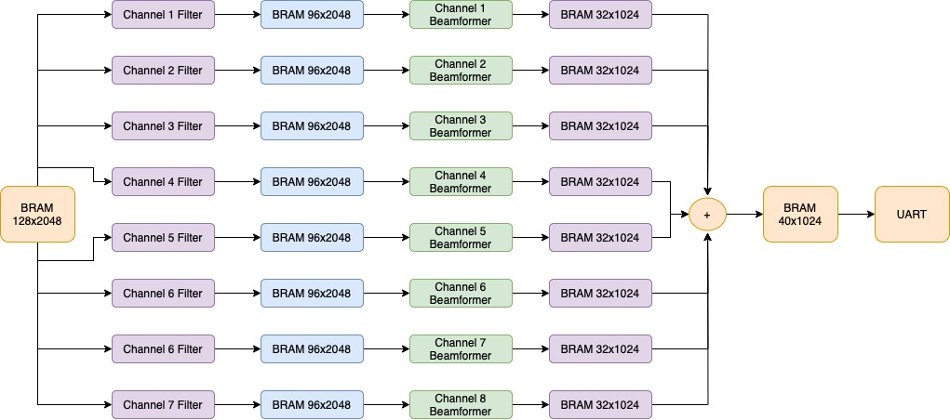
Proposed System

Slide 4

System Architecture

Slide 5
Filter Design
Low Pass Filter Design that will up sample by 3 interpolations.
Sampling Frequency = 300 MHz, FPass = 45 MHz, FStop = 50 MHZ
Input 16 bits – Output 96 bits achieved by truncating 3 bits

Slide 6
Beamformer Design
w

Slide 7
Summing Design
w

Slide 8
UART Design
w

Slide 9

Testing

Slide 10
Initial Testing
w

Slide 11
In-Progress Testing
w

Slide 12
Final Testing
w

Slide 13
Final Results
w

Slide 14

Conclusion & Questions

